Slide 1
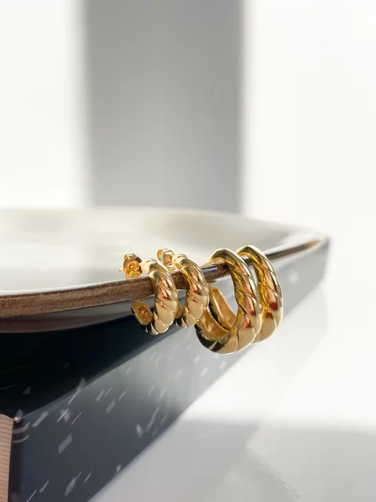
July 2023
2023
S | M | T | W | T | F | S
 |  |  |  |  |  | 1
2 | 3 | 4 | 5 | 6 | 7 | 8
9 | 10 | 11 | 12 | 13 | 14 | 15
16 | 17 | 18 | 19 | 20 | 21 | 22
23 | 24 | 25 | 26 | 27 | 28 | 29
30 | 31

Slide 2
Project 1
Adorna Jewelry Store
Student: Nguyễn Thị Khánh Huyền
Lecturers: Lê Y Khoa
Class: JS230529

Slide 3
REASSONS CHOOSING THE TOPIC
“Fashion is evolving. Our pieces are a merge of luxury, vintage pieces for every wear.”

Slide 4
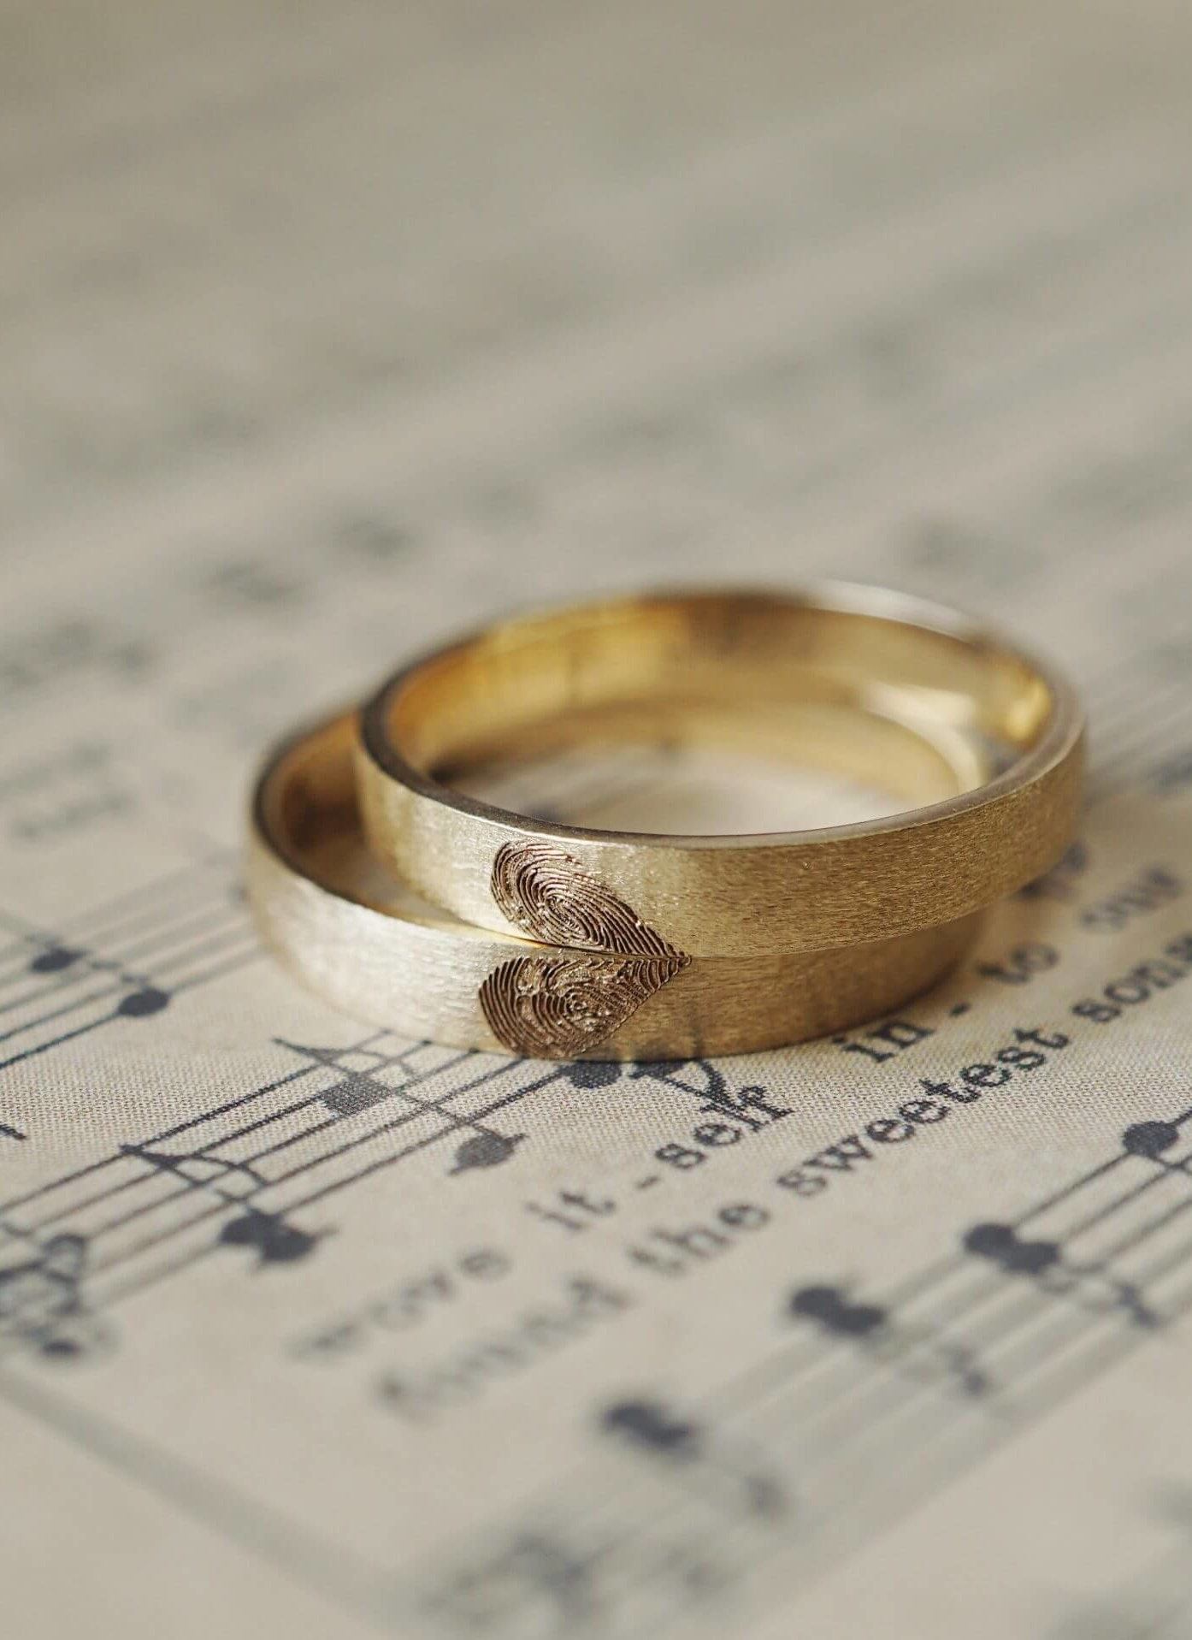



Created By

Slide 5
Function
User
Function
Admin
Users Management
Login
Products Management
Register
Logout
CRUD products
Payment
Shopping Cart Management
Search Product

Slide 6
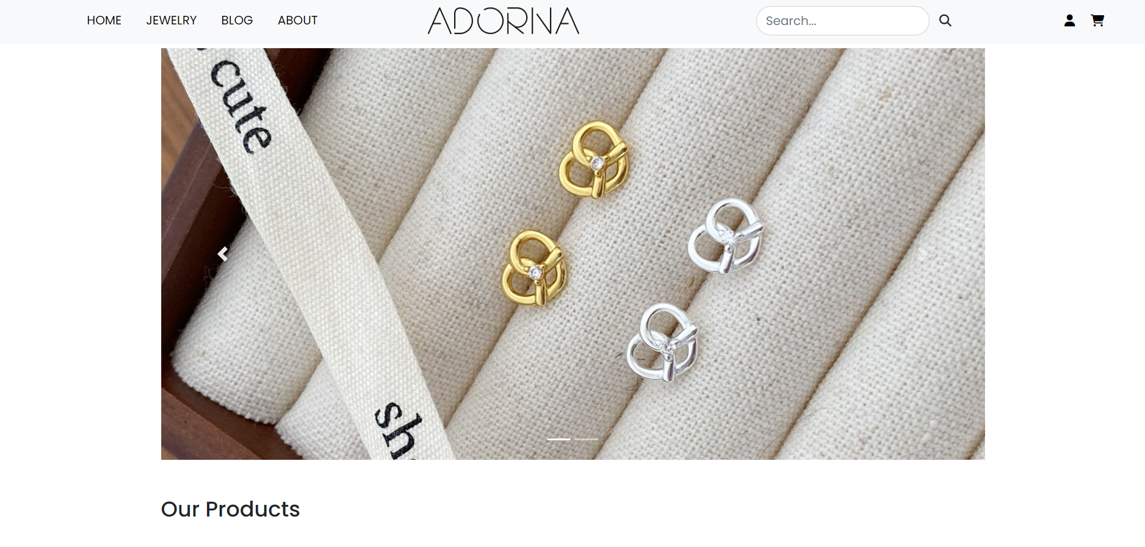

Slide 7
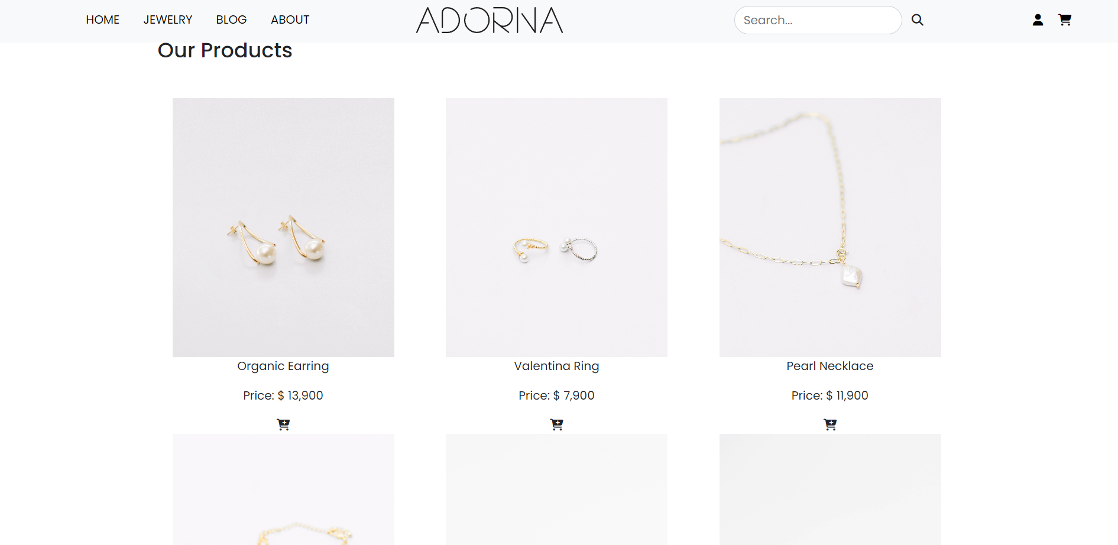

Slide 8
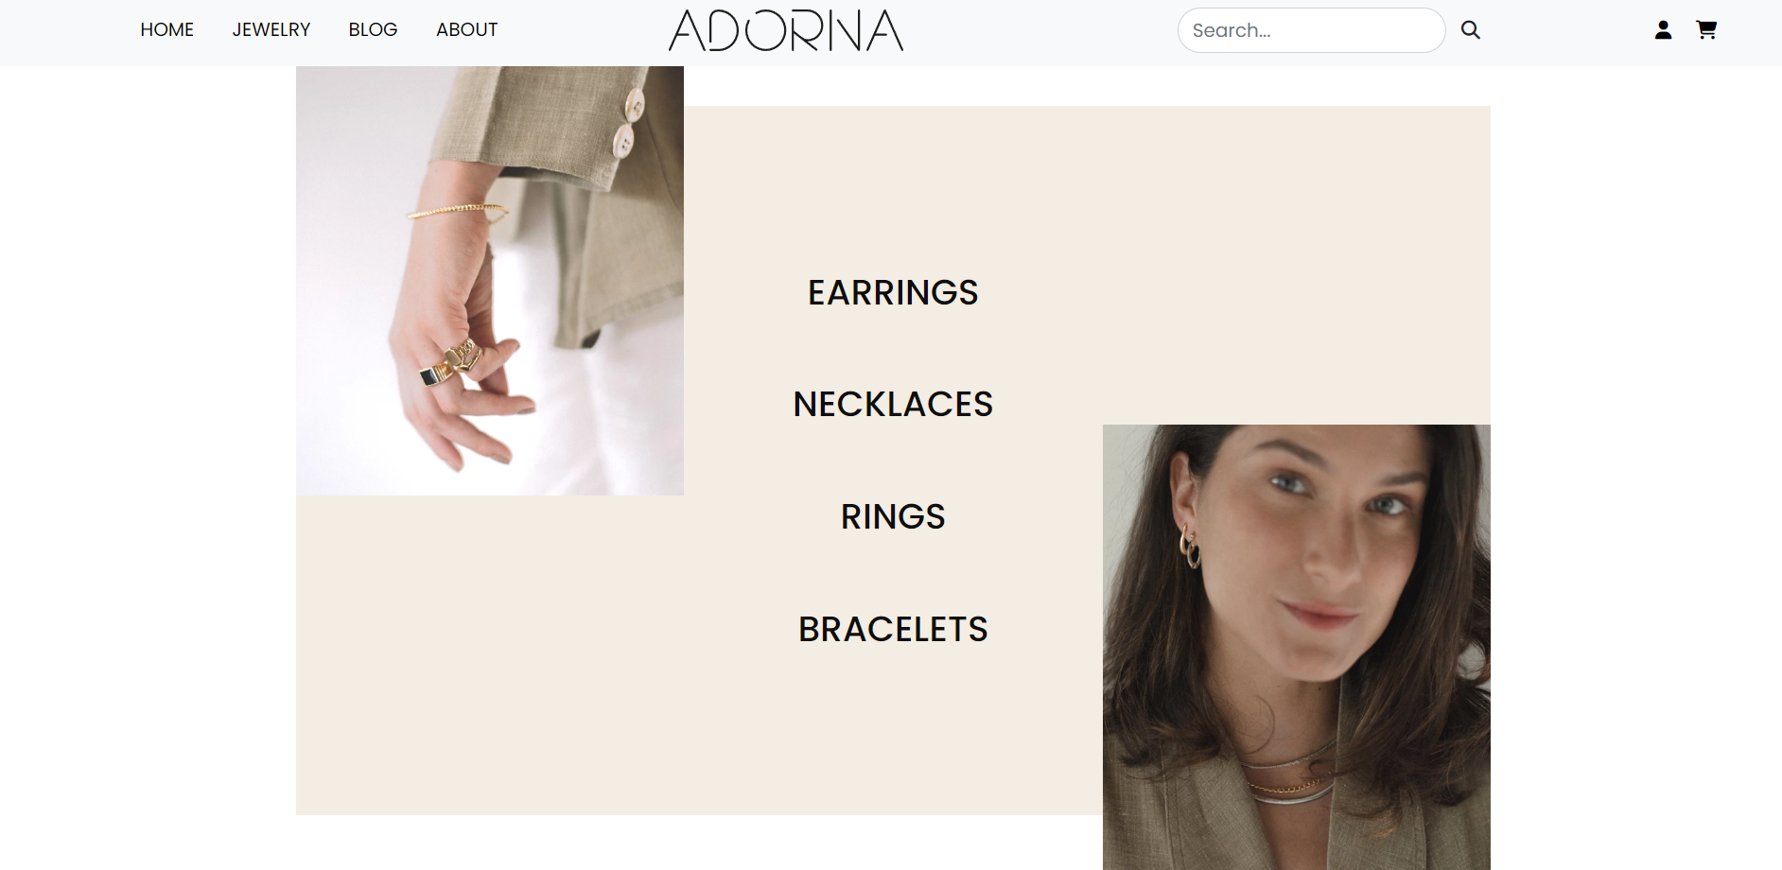

Slide 9
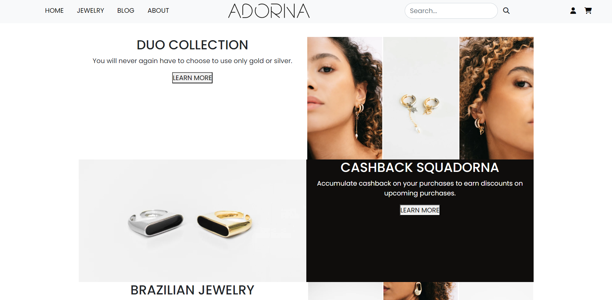

Slide 10
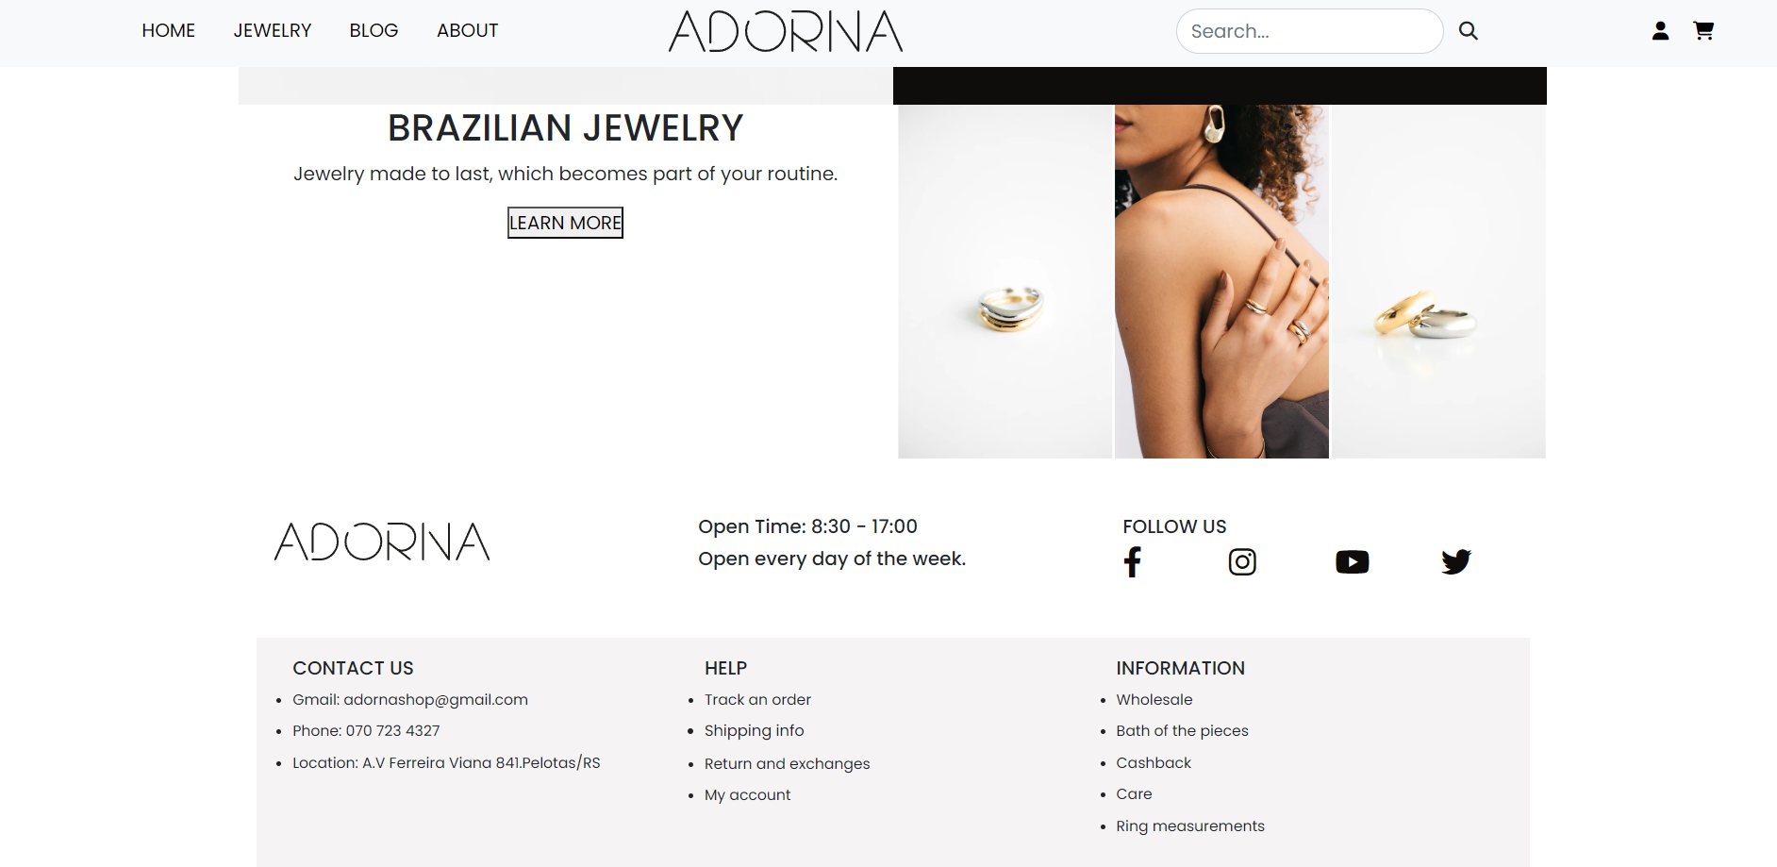

Slide 11
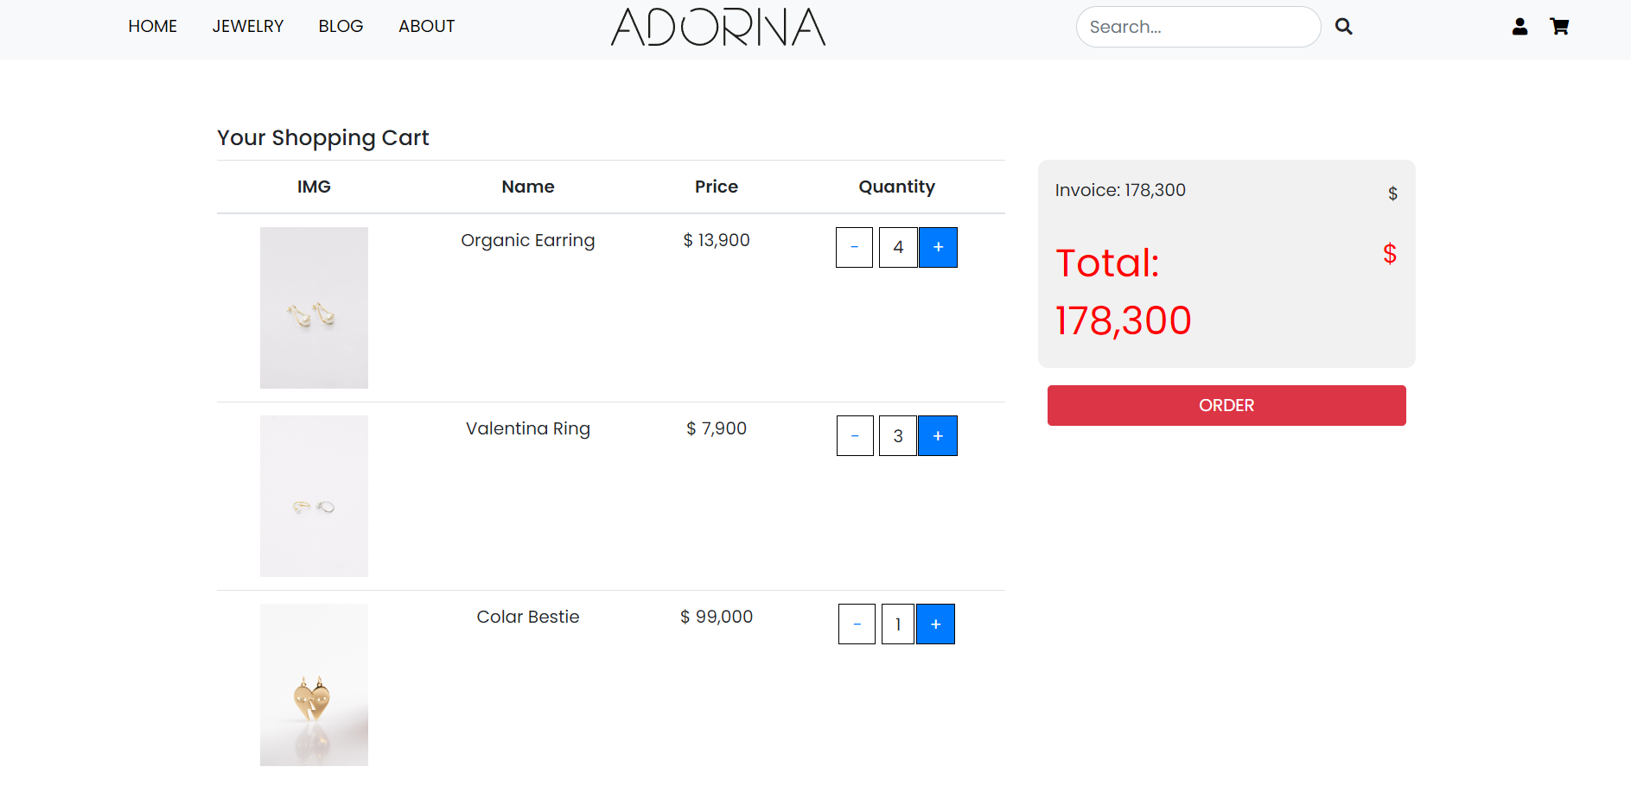

Slide 12
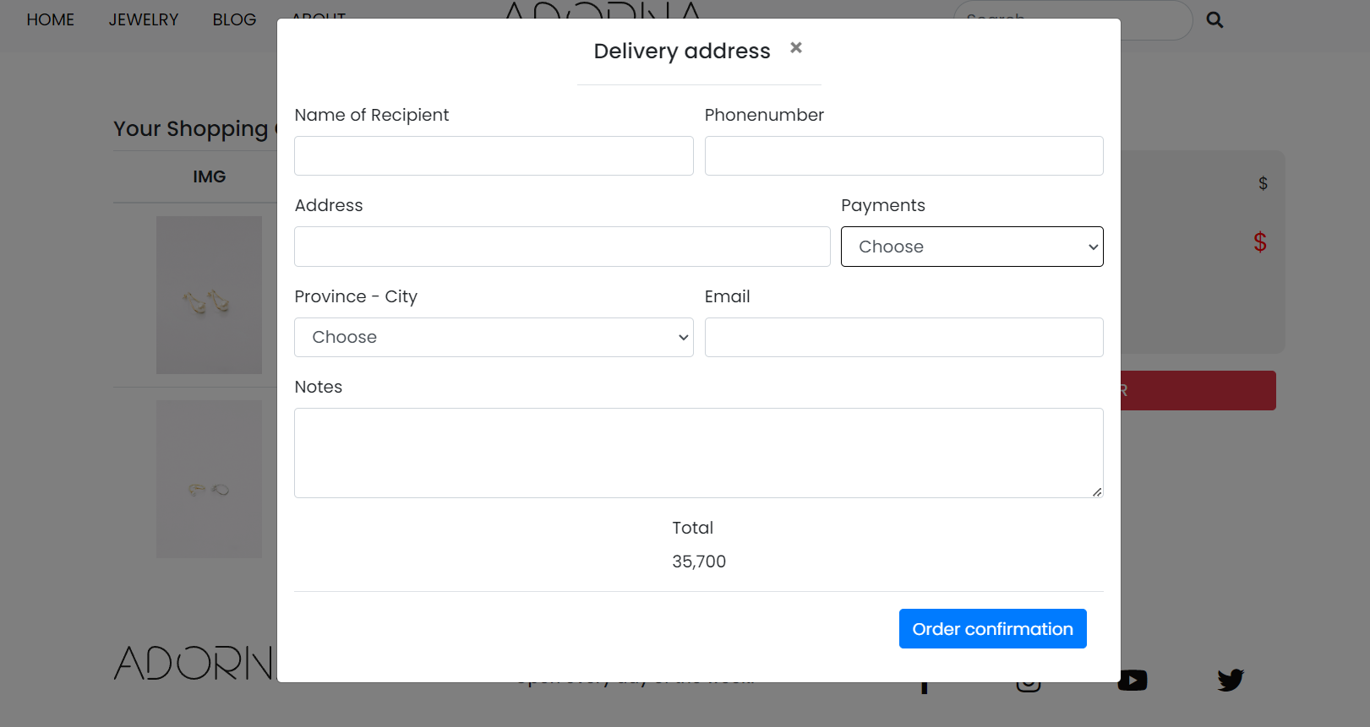

Slide 13
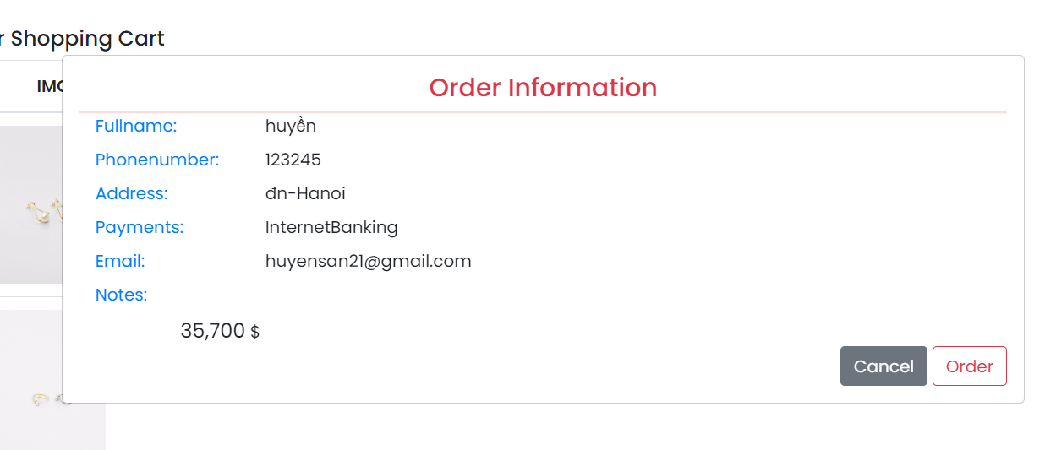

Slide 14
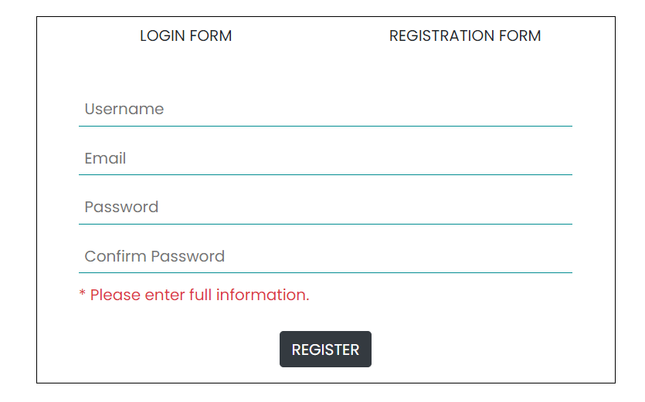
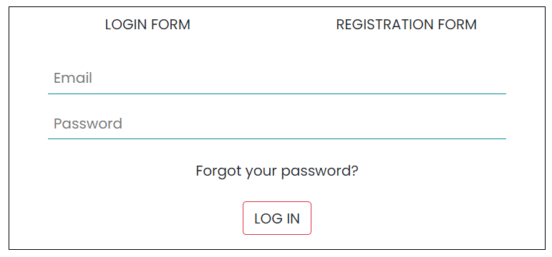

Slide 15
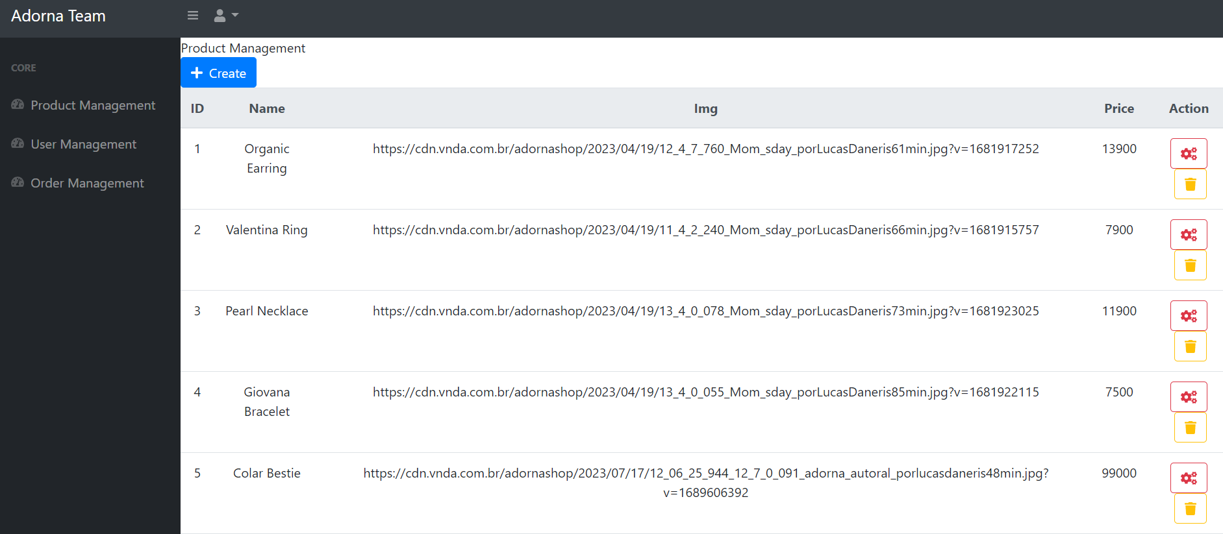

Slide 16
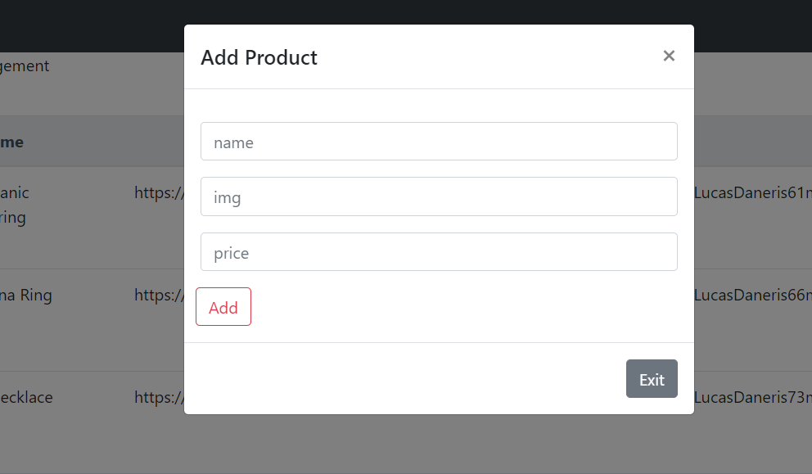
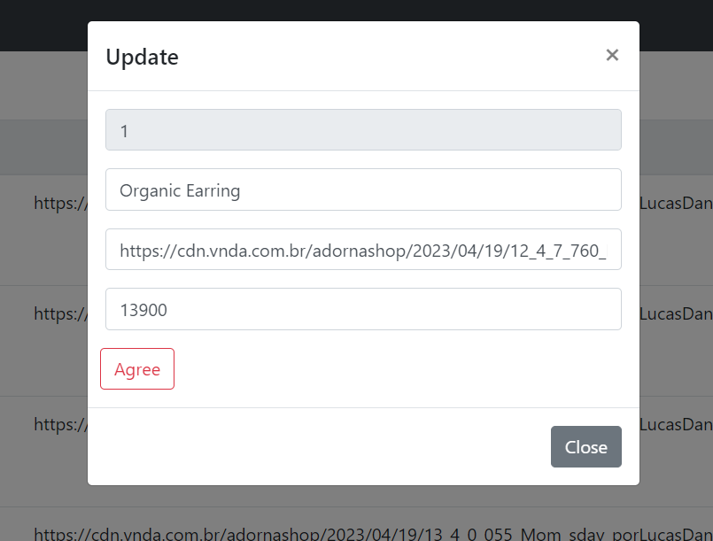

Slide 17
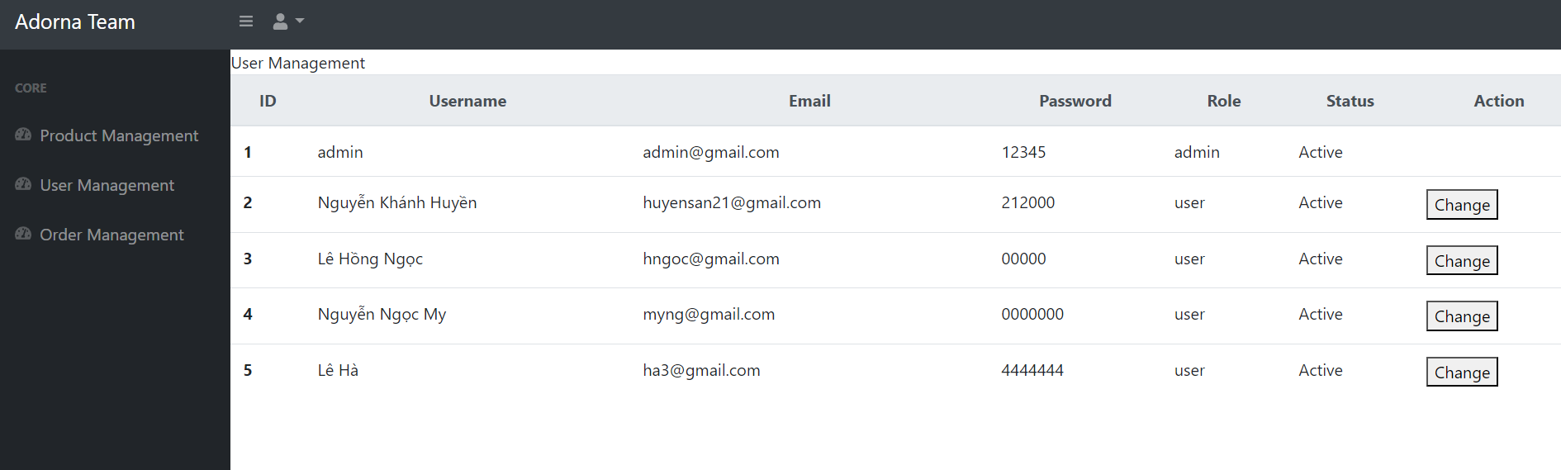

Slide 18
Thank You
Adorna Jewelry
adornashop@gmail.com
www.adornashop.com

